Slide 1
“Realm”
Group 8 – PIGDE – Oral assessment
UP2260587 - Finley Hanham
UP2278088 - Hritesh Lama
UP2277517 - Dylan Veeroo
UP2267728 - Skye Wasko

Slide 2
Video
A refresher as to what “Realm” is.
Notes:
Backup link:

Slide 3
Some admin before we start
Most slides contain references to project documentation where it has not been suitable to copy all the information.
Slides will be tagged with a ‘bookmark’ and file / folder where this happens.
These bookmarks are also colour coded to aid with navigation.
Pink -> Internal team communications (Sections 1 & 2)
Black -> Research and analytical documents (Sections 2 & 3)
Blue -> Information regarding playtests (Sections 4 & 5)

Slide 4
Preparing for development
Versions V-0.1.A through V-1.0.A

Slide 5
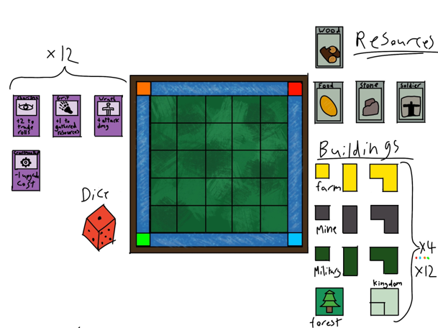
Core DNA of the game
Version 0 of the game revolved around a few key features:
Build structures to gain resources
Upgrade structures to win
Skills modify individual gameplay
Compact board to encourage PvP
Patch notes – Realm

Slide 6
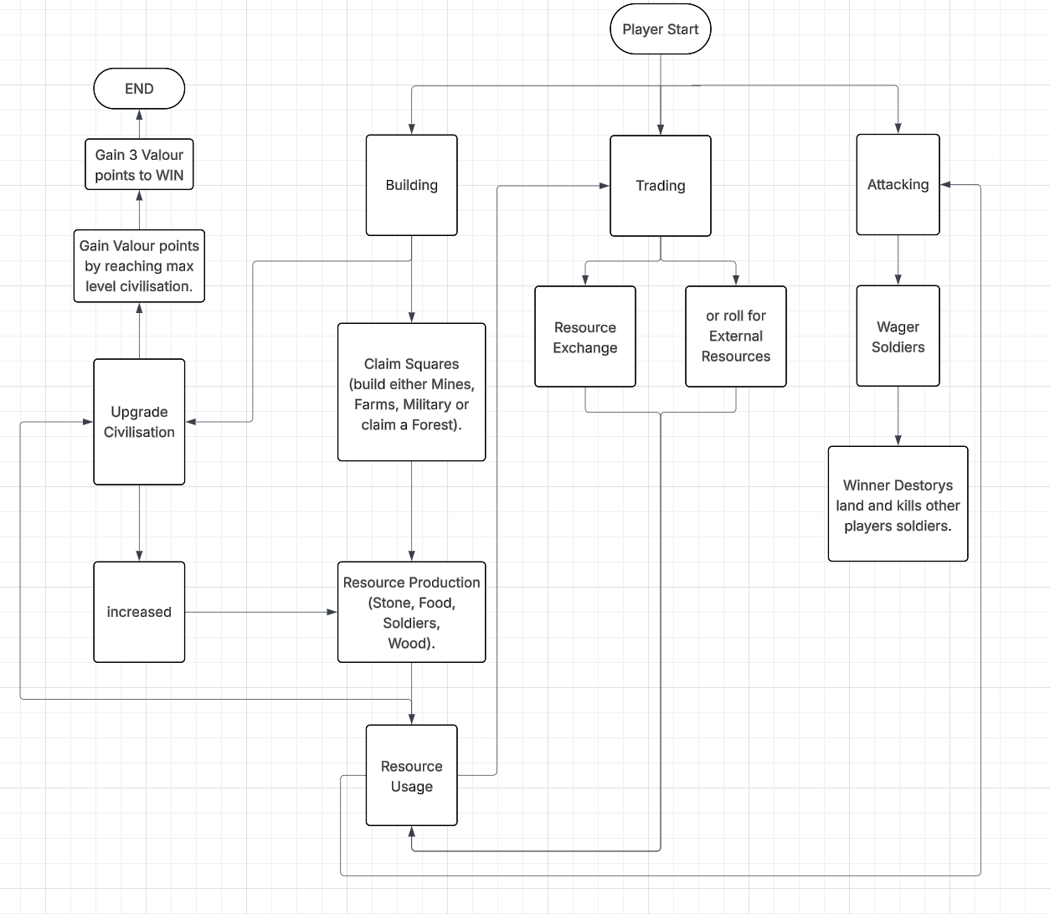
Core DNA of the game
Version 0 of the game revolved around a few key features:
Build structures to gain resources
Upgrade structures to win
Skills modify individual gameplay
Compact board to encourage PvP
Notes:
Discuss mechanics from a design perspective

Slide 7
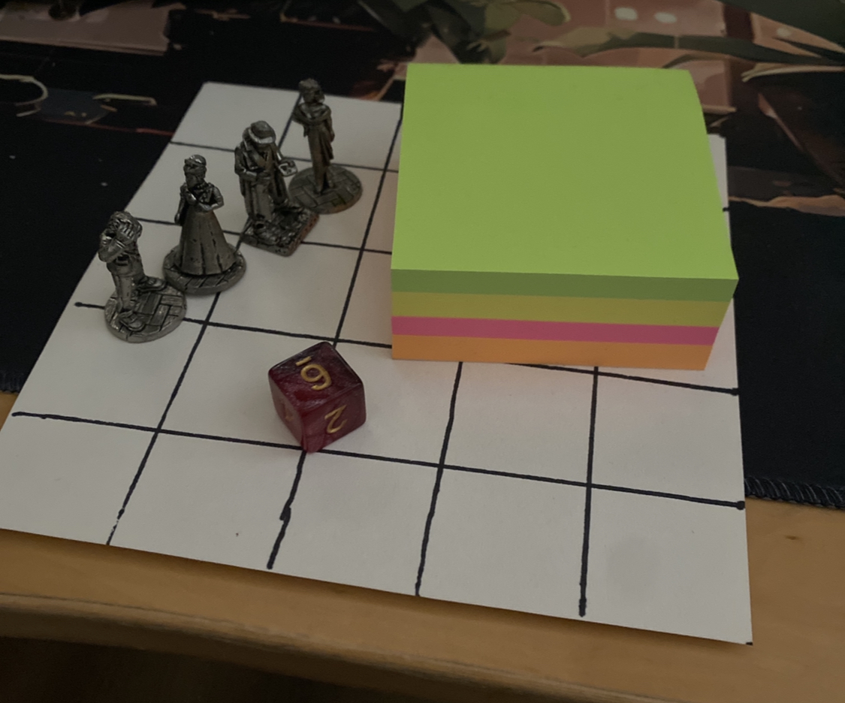
Conversion to analogue
Aims for components:
Minimal components
Can be damaged
Most adaptable
Compromises
Compromises:
Relies on honesty
Confusing base visuals
Finicky to handle
Easy to forget skill claims

Slide 8
Learning from existing titles
Cartographers
Tiny Towns
My City: Build and Roll
Risk
(Thunderworks Games, 2019)
Simultaneous play: All players respond to the same cards, reducing downtime and increasing engagement.
Puzzle-like placement: Maximizing points requires careful planning and adapting to obstacles.
Dynamic card system:
Terrain and monster cards create variable challenges and strategies.
Roleplay as royal cartographers: The theme of mapping the kingdom for the queen is tightly integrated into gameplay.
(Alderac Entertainment Group, 2019)
Highly replayable: Every game is different due to changing resource choices and player decisions.
Multiple scoring paths: Different buildings and bonuses create varied strategies for winning.
Resource pattern matching: Buildings require specific combinations of resources, adding puzzle-like strategy.
(KOSMOS, 2022)
Competitive yet personal: Players build their own city boards simultaneously, creating unique experiences for each player.
City-building theme: Strong focus on urban planning, balancing growth, rivers, and obstacles.
Dice-driven building: Instead of fixed tiles, dice determine building shapes, adding randomness and replayability.
(Hasbro, 1957)
Global conquest theme: simulate world domination and military strategy on a global scale.
Dice-based combat: Introduce strategic planning, balancing luck and skill.
Territory control mechanics: Strategic placement and movement of armies
High player interaction: Direct attacks, alliances, and competition make PvP tense and engaging.
RESEARCH – Existing titles

Slide 9
Preparing for player feedback
MS Forms selected for ease of use, integration with other software such as Excel and built in QR code sharing option.
Initially written such that it was impractical to use given length.
Rewritten to be shorter, less leading and to try and gain more pertinent data.
MS Form (Folder)

Slide 10
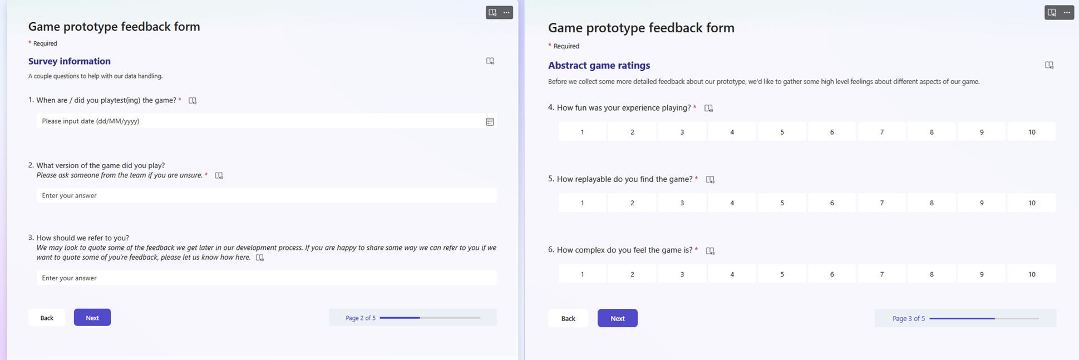
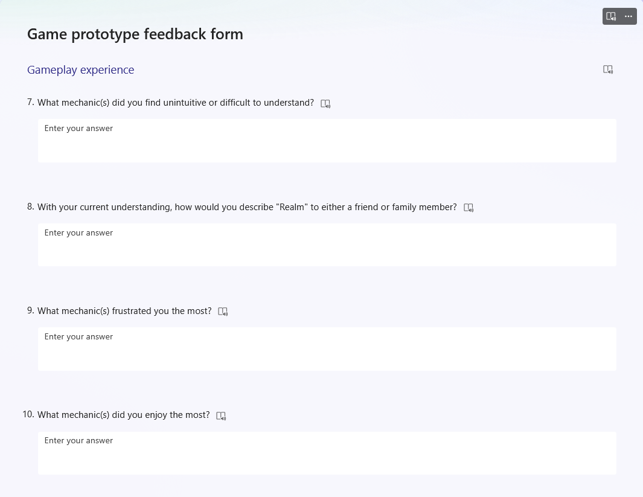
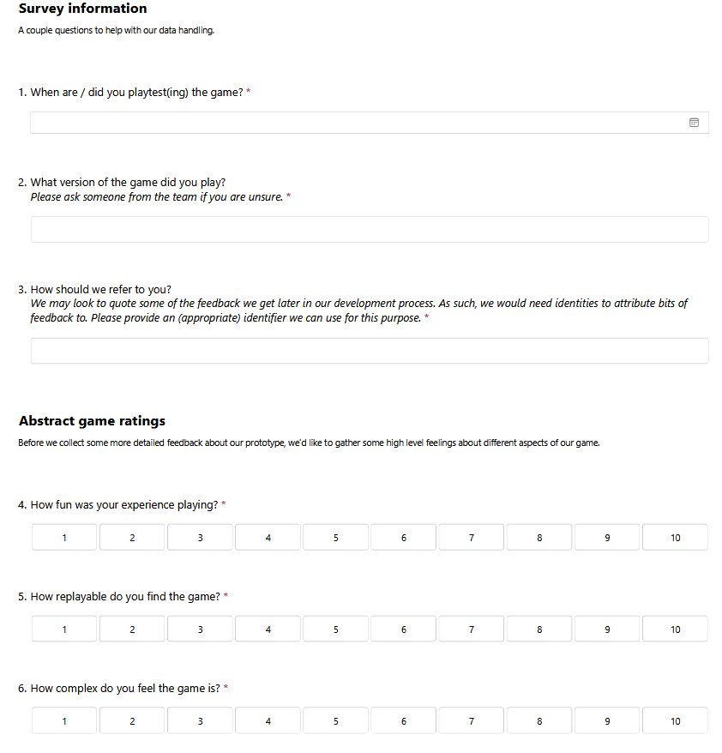
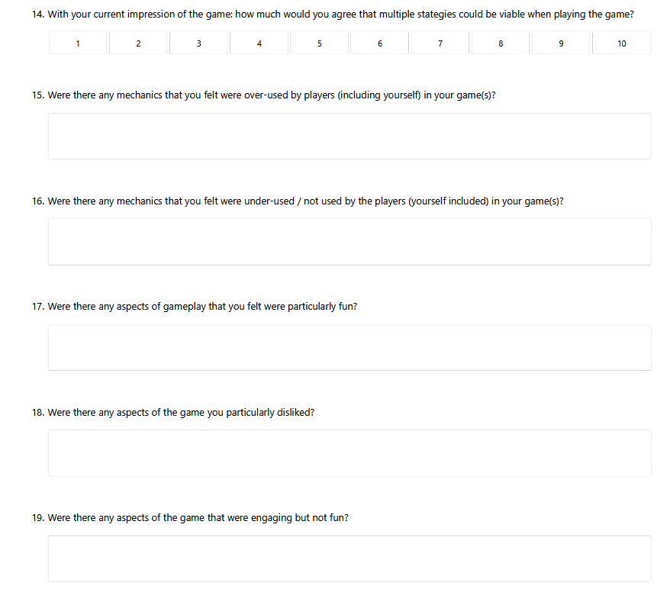
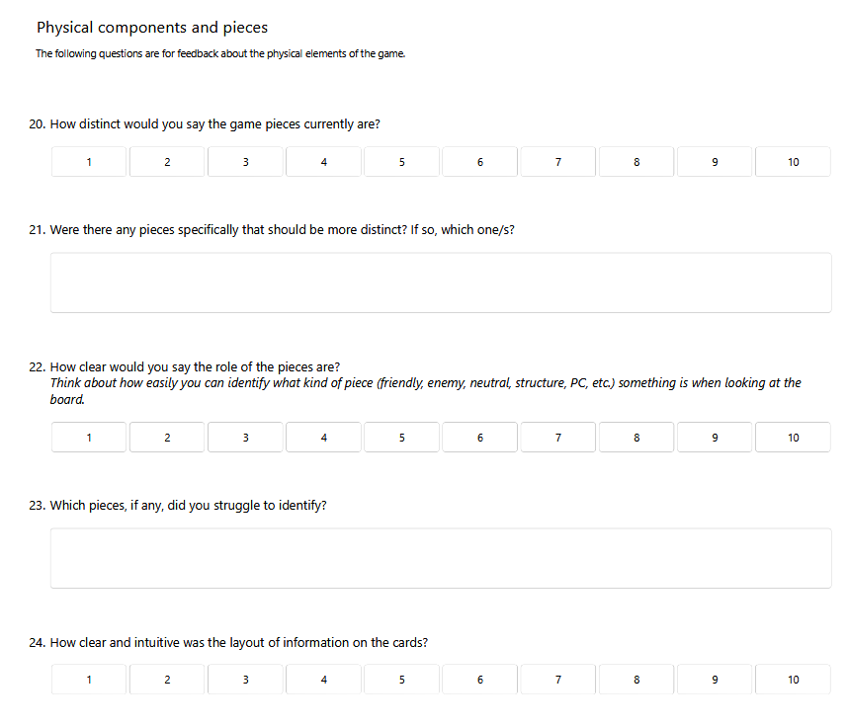
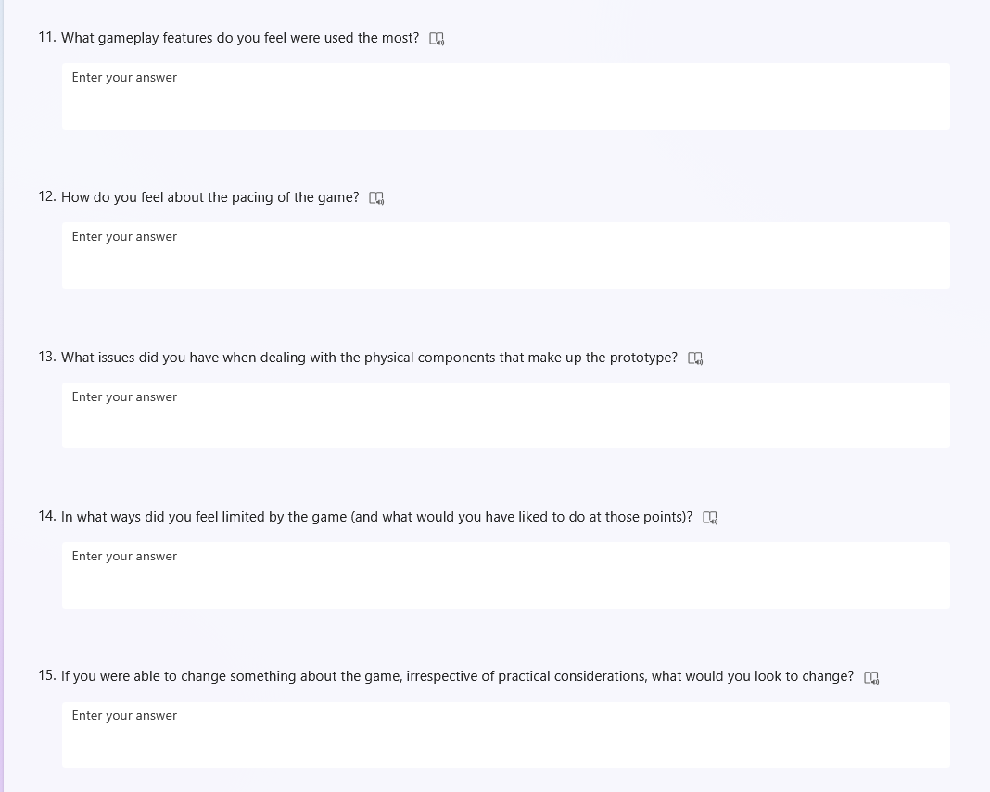
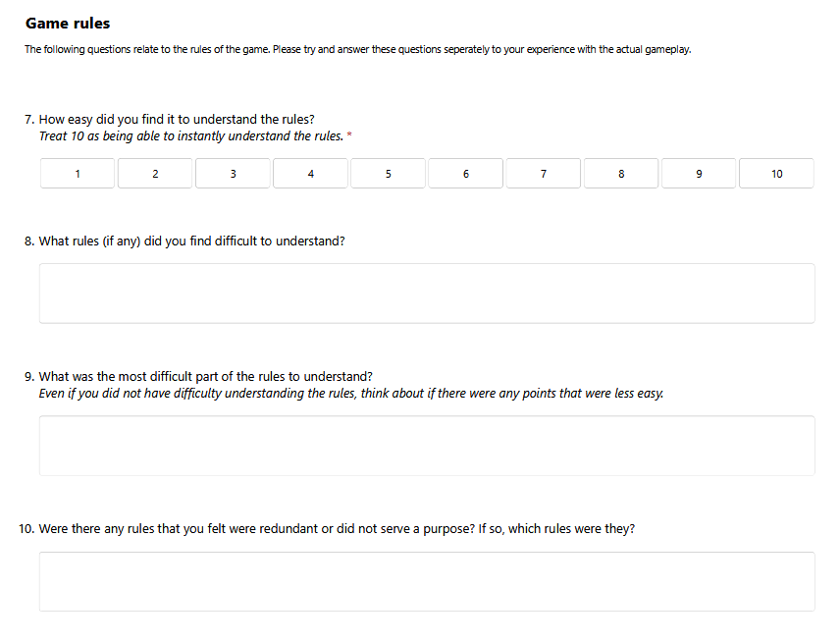
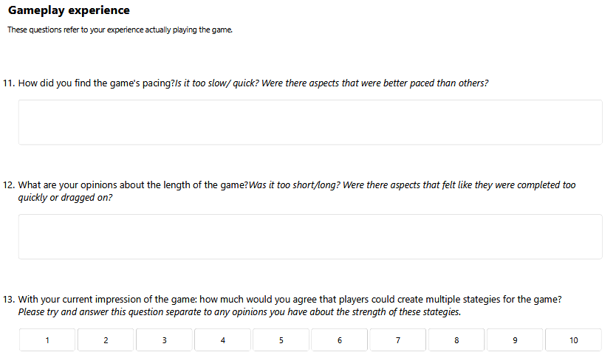
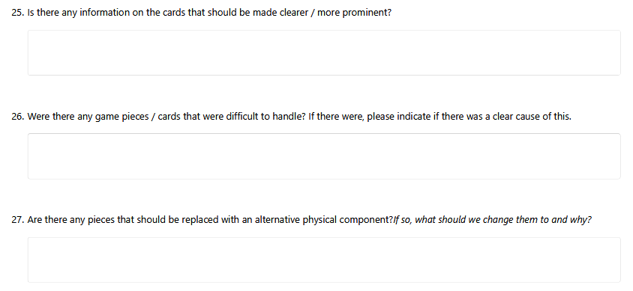
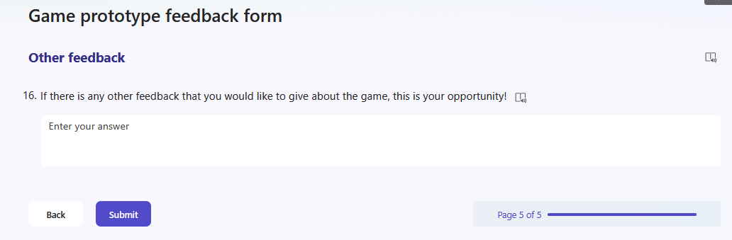
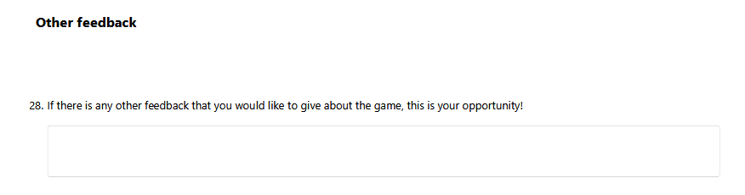
Preparing for player feedback
MS Form (Folder)

Slide 11
Reworking Systems
Versions V-2.0.A through V-4.1.A

Slide 12
Rapid testing
Aimed at bringing systems into roughly the right ballpark and identify more complex issues.
Hallmark change: win condition reduced from 3VP to 1VP. (3 cities to 1)
Skills rework given they were defining strategy rather than supporting strategies.
Resource production timings changed to try and ensure all turns have meaning.
Flagged the combat and trading systems for further review.
Patch notes – Realm

Slide 13
Removing limiting factors
To get to the next stage of testing, a couple of obstacles had to be removed:
Physical components are not intuitive
Components are not reusable
Full aggression is a dominating strategy reducing playtest variance
Example feedback (from non-team play testers):
“With the pieces and such, it will be a lot easier to understand.”
“Currently trading seems to be a weak strategy.”
“Not much honestly If they were abit heavier it might feel nicer but the thicker card was very usable.”
RESPONSES - Game prototype feedback form
Patch notes – Realm
Notes:
First quote is from the V1 playtest before the form went live.
Second quote is from V-2.0.B playtest w/ Niel
First quote is an answer to the question on the physical components.

Slide 14
Researching for solutions
Improving player vs player interactions
Improving resource management
Improving game accessibility
RESEARCH – Pressure points
RESEARCH – PVP styles

Slide 15
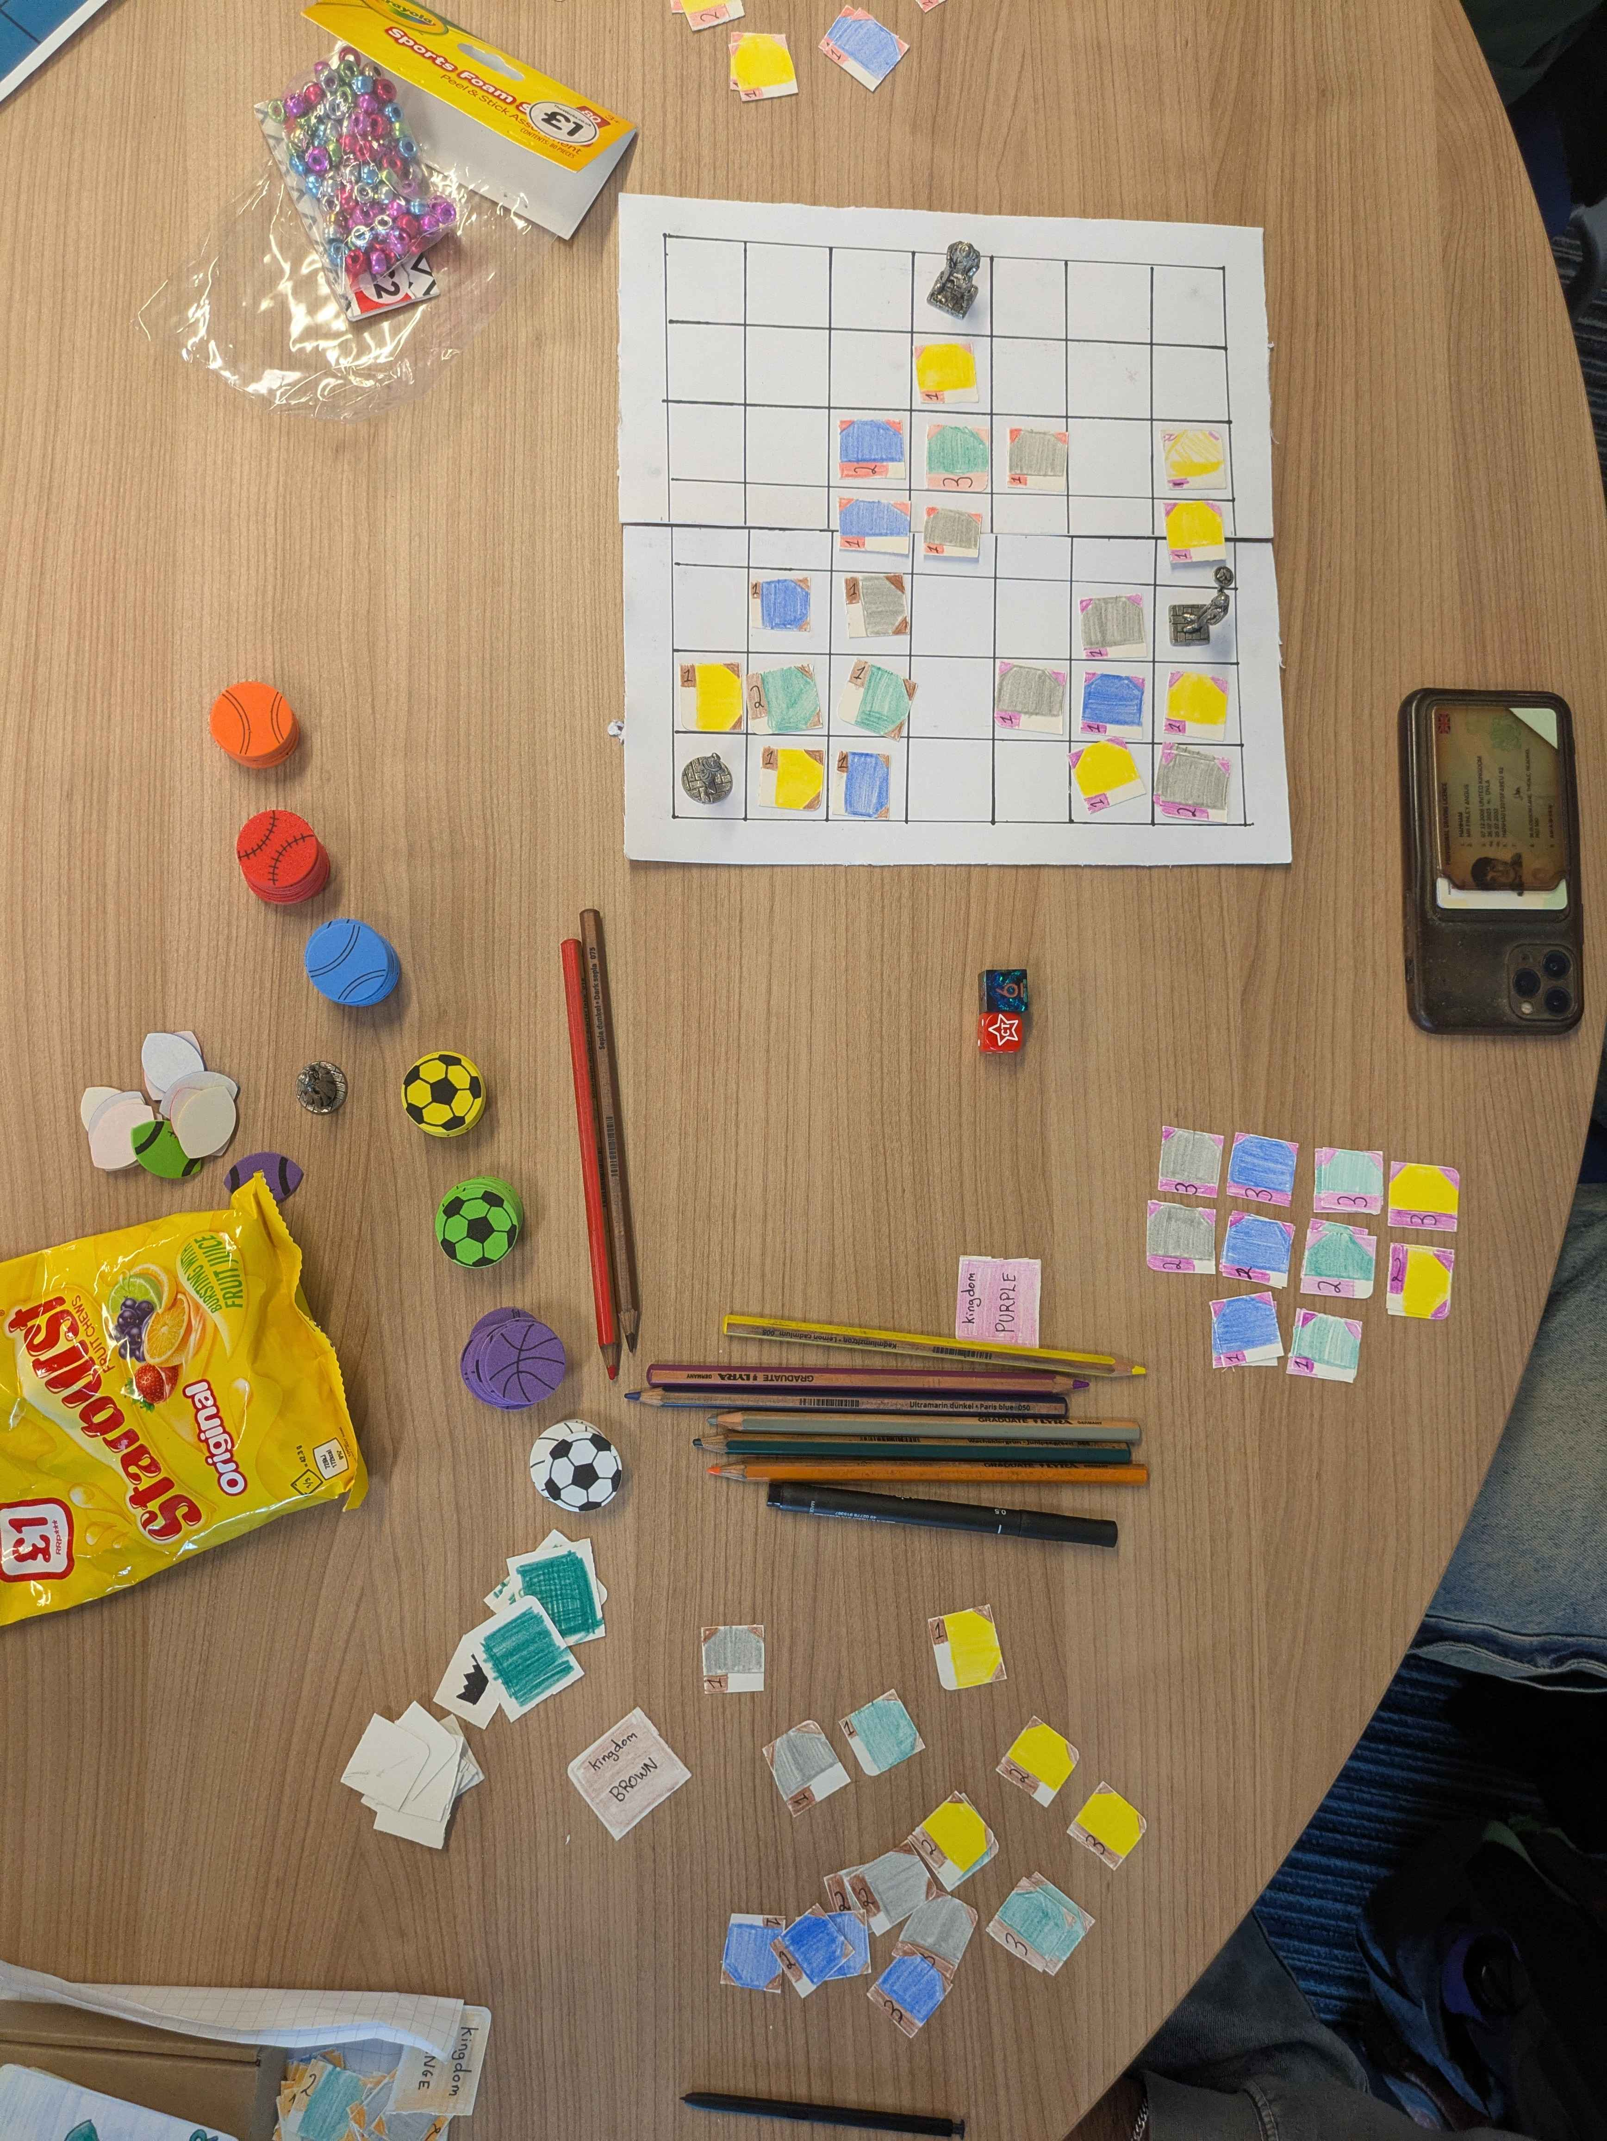
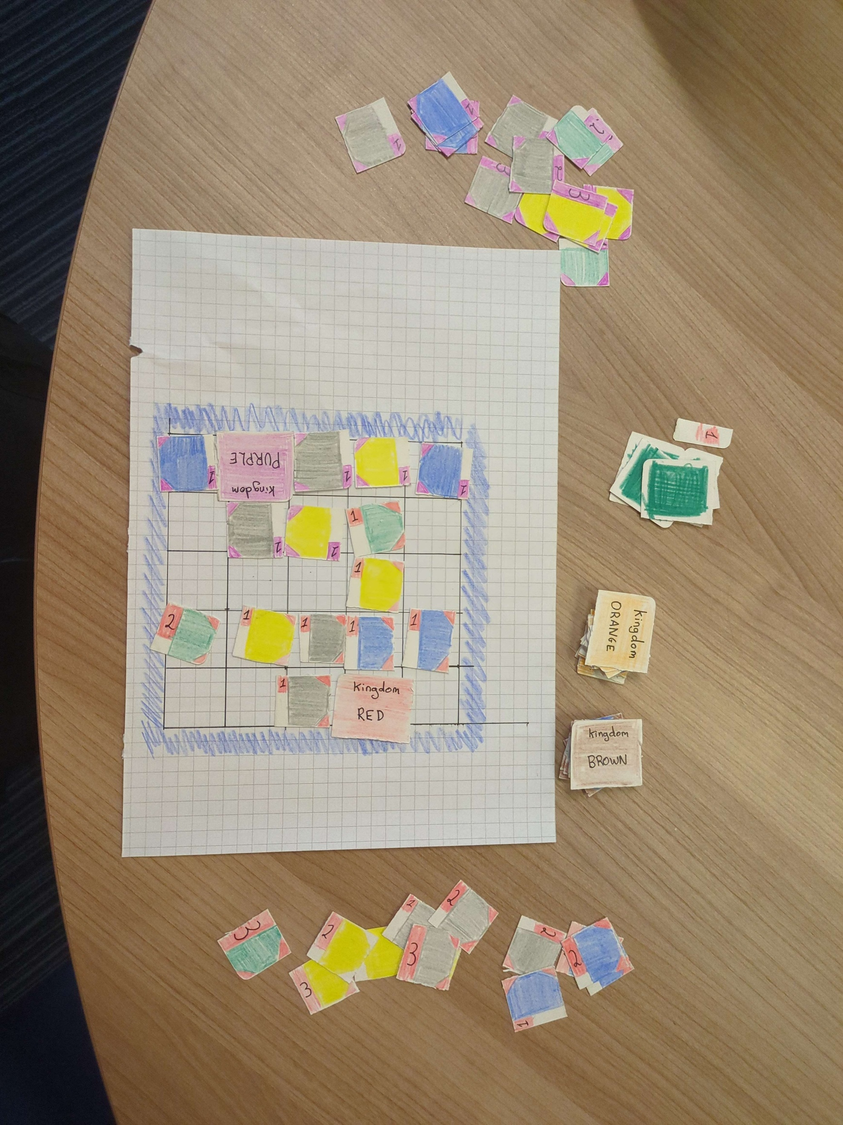
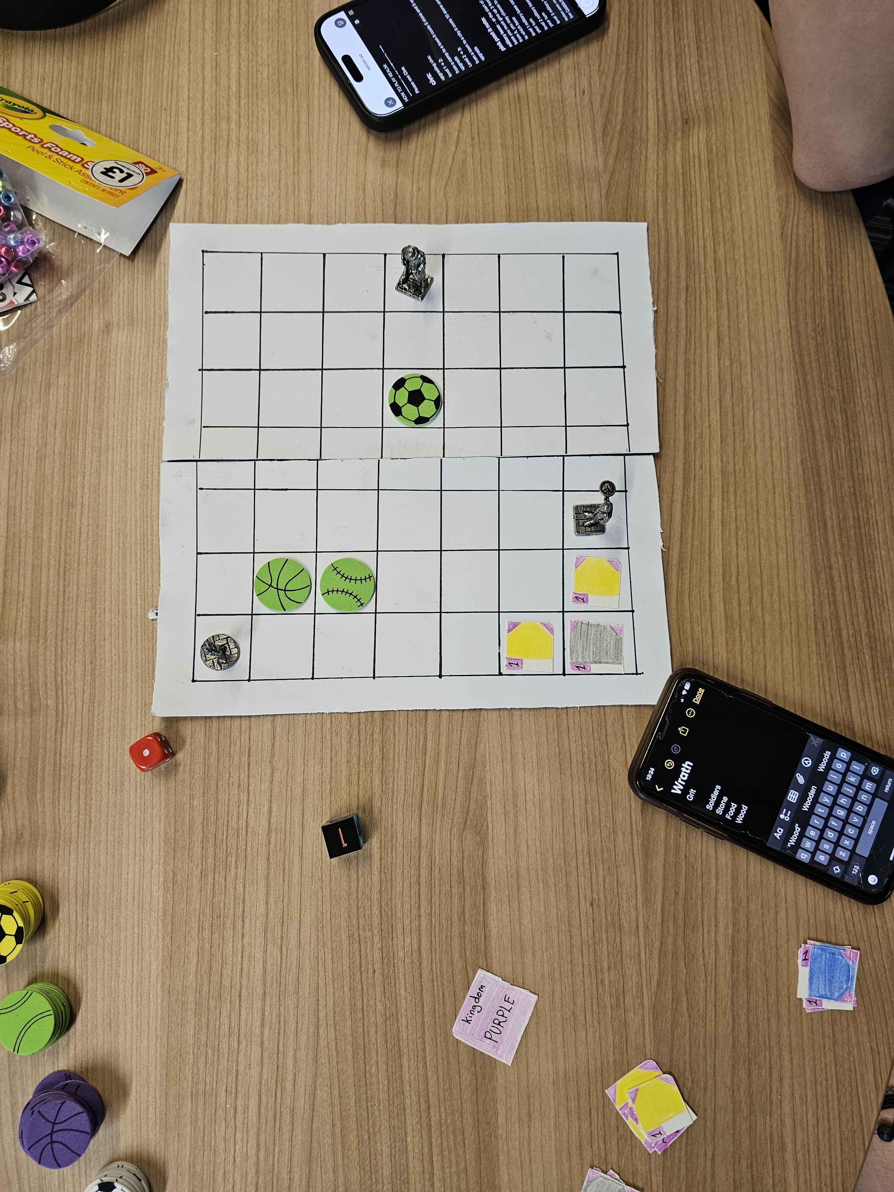
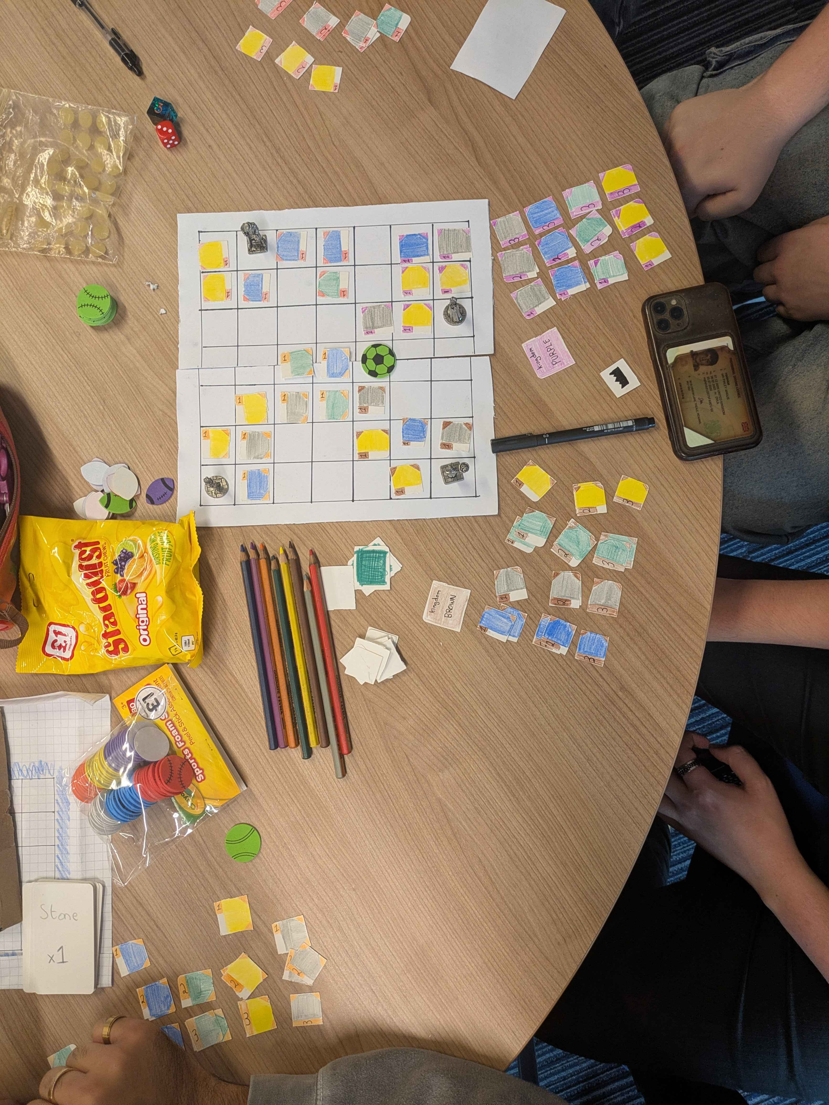

Slide 16
Game level Considerations
Version V-5.0.A through V-7.0.A

Slide 17
Persistent issues
Resources
Tracking resources is difficult without physical tokens
Prone to large swings in amounts
Combat dominance
Maintained dominance despite nerfs
Still lacking proper checks against snowballing
2 player stalemates
Actions feel binary in nature (helps either you or your opponent)
Ripe for uncontrolled positive feedback loops
Transient in nature
Forest generation
Randomness too volatile, causing issues too frequently
Reducing numbers for smaller games limits incentive for expansion

Slide 18
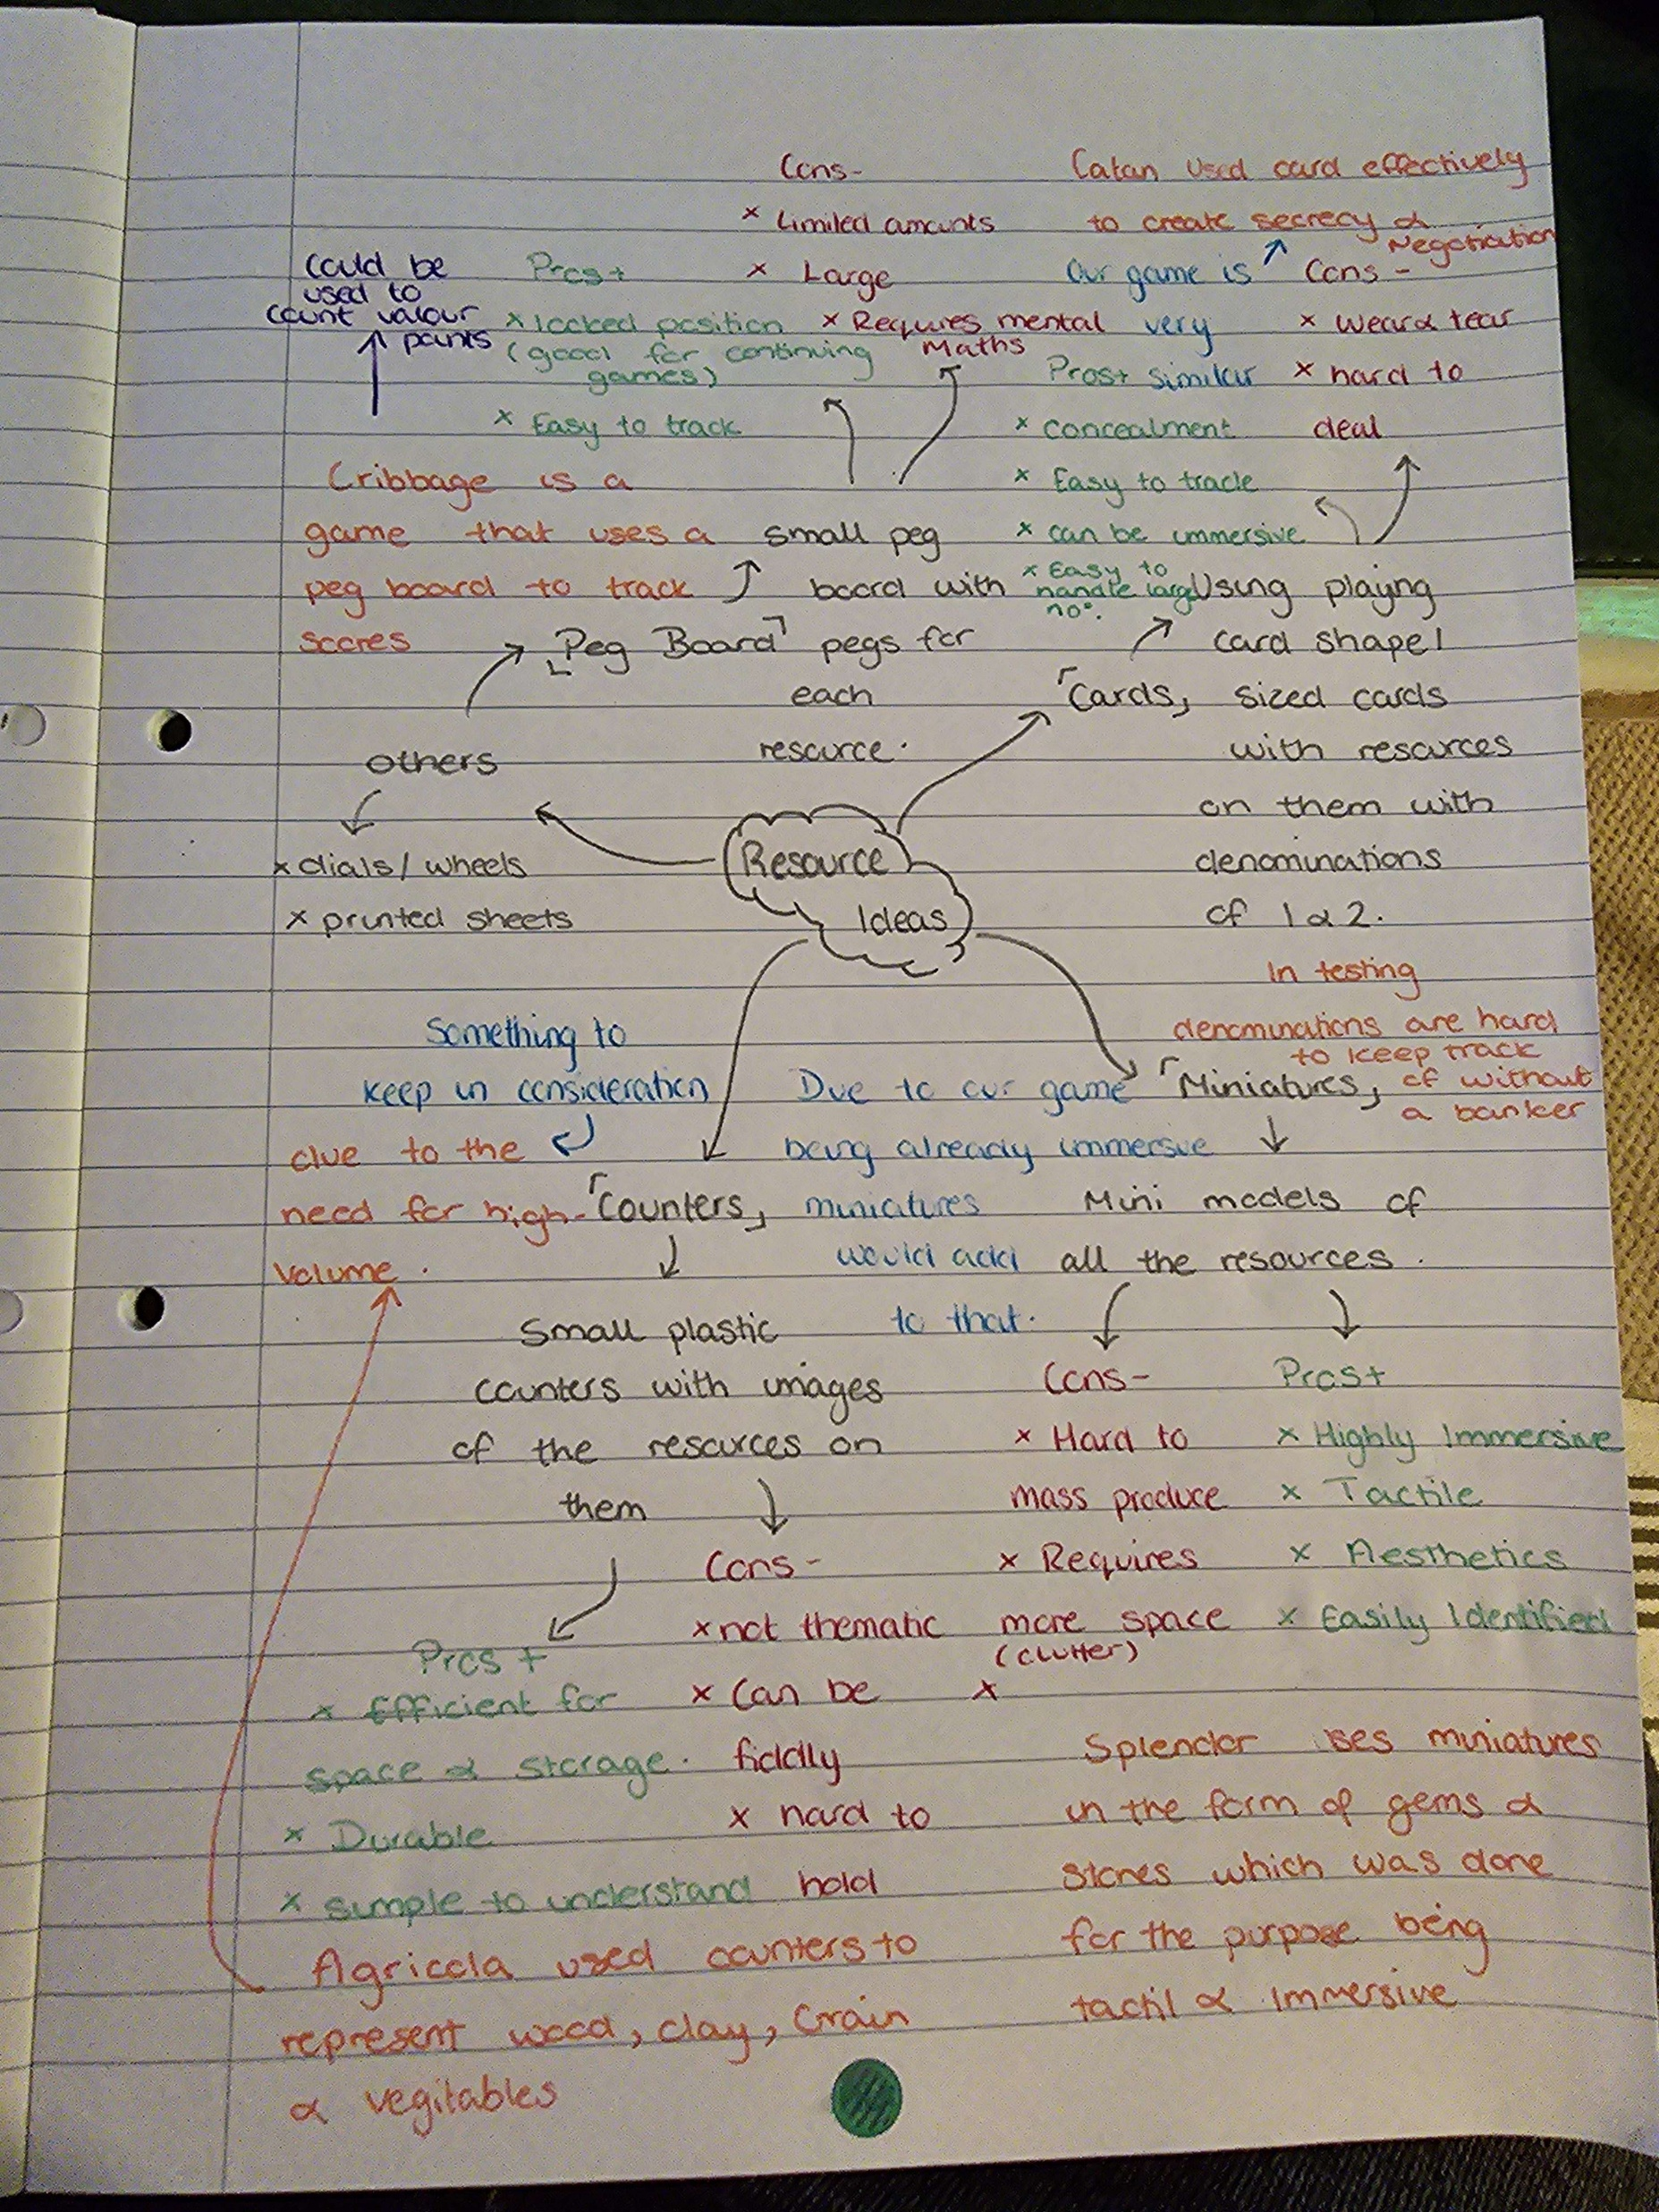
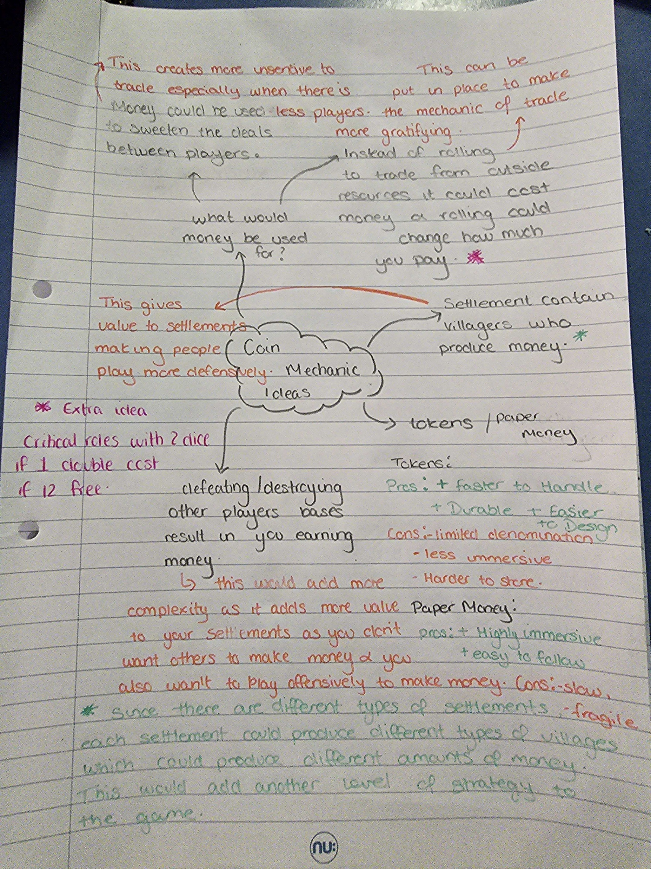
Economy rework
Three elements up for review:
Resource tracking
Source & sink rates of use
Immutability of resource types
Strategy was to explore an expanded set of options and then focus back in on selected areas.

Slide 19
Economy Rework
Patch notes – Realm
Economy Rework (Folder)

Slide 20
Trying to prevent stalemates

